Slide 1
Using computers safely, effectively and responsibly – End of Unit Test
Year 7 – Mrs Perry

Slide 2
File types
All files will have an appropriate name
Files also have an extension such as .doc
This indicates the type of software application that can be used to open them
.doc
.jpg
.ppt
.html
Question what are these applications and what are they used for?
Examples:
lMcDonald.doc
Lunchbudget.xls
ScratchLesson2.ppt
LVLogo.jpg

Slide 3
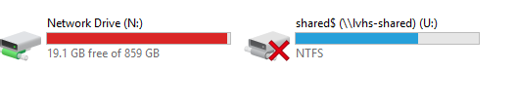
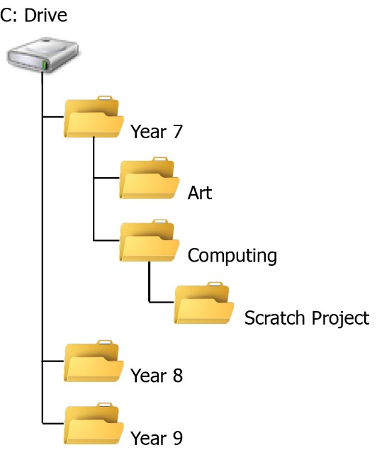
Drives and Folders
Files at saved in folders and drives in order to organise the files and find them easily
Files should have appropriate names and put within a folder which is saved on a drive.
Worksheet1 is saved so that you can retrieve it from the shared area drive – it can be found using the following path: U:\Students\_Curriculum Areas\ICT\ Year_7\Using_Computers_Safely,_Effectively_And_Responsibly\Lesson_1_(File_Management)
An example of a student directory structure within their network drive

Slide 4
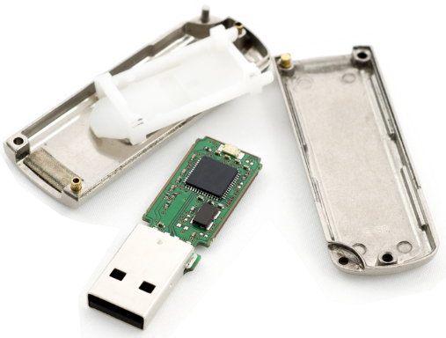
Backups are important!
Where to store a backup
Computer drives can fail
A virus can corrupt your work
A laptop or iPad can be lost or stolen
You might accidentally delete a file
What else could happen?
One of the safest places is online – then even if you lose your flash drive, iPad or PC, or the school file server is destroyed by fire, you can still access your backup
Can you think of some methods of backing up important files online?

Slide 5
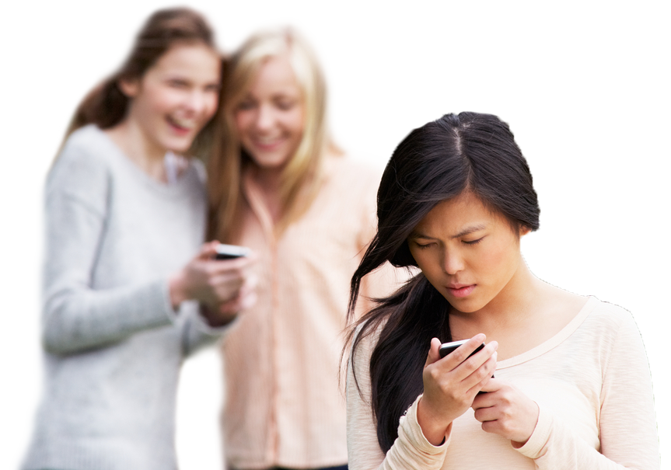
Cyberbullying
“Bullying others through the use of technology, for example a mobile phone or the Internet.”
Includes: threats, rumours, identity theft etc…
Don’t reply, however tempting
Block the sender
Keep any evidence
Tell somebody
Use a ‘Report’ button

Slide 6
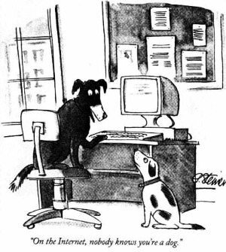
Online strangers
How can you check that the person you are speaking to online is who they say they are?
Only add people to your social network who you know offline

Slide 7
Inappropriate content
Posting inappropriate content
Malicious or personal attacks on others (cyberbullying)
Impersonating another person or company without permission
Personal or confidential information about others
Sexually explicit material (nudity, pornography)

Slide 8

Reporting concerns
Through the website - Report button
Informing an adult or parent
Who was posting the content?
What were they posting?
Risks of having an online presence?
Nothing can ever be deleted - what you might be proud of now, you might be embarrassed about in time
Future employers could access your old profile
This may not accurately describe the ‘new’ you
This may not accurately describe the responsible ‘at work’ you

Slide 9
Keeping your data safe
Spam
What is spam? (we’re not talking about tinned meat!)
Electronic junk mail!
Unsolicited messages sent over the Internet.
Usually sent to large numbers of people.
Purposes: Advertising, Phishing, Spreading malware
Phishing
The act of stealing personal information by sending emails that appear to be from legitimate websites, ie, your bank, Paypal, Facebook, Twitter etc. Look out for:
Greeting: The phishers don’t know your name, so the greeting is not personalised
The sender’s address is often a variation on a genuine address
Forged link: The link looks genuine, but it may not link to the website given. Roll your mouse over it to check
Request for personal information: Genuine organisations never ask you to provide personal information via email
Sense of urgency: Criminals try to persuade you that something bad will happen if you don’t act fast
Poor spelling and grammar: Generally phishers are not good proof-readers

Slide 10
Secure Passwords
It’s important to protect our data with secure passwords.
Ideally use a different password for different sites. Why?
NEVER share your school password (even with your friends)
Automated hacking tools can hack passwords of up to 10 characters!
Use at least 8 characters
Use a mixture of UPPERCASE and lowercase letters, numbers and symbols
How can you choose a memorable password?

Slide 11
Antivirus Software
What does antivirus software do?
Checks files when they are opened to protect from viruses.
Scans the computer regularly for viruses.
Removes viruses from the computer.

Slide 12
Firewall
What does a firewall do?
Limits data that can pass through it to protect your computer system from unauthorised users.
A router is a hardware device that has a built in firewall.
Operating systems also have firewall filters.

Slide 13
Advantages of email
Can send to multiple recipients at once
Can send attachments
Sent instantly at any time
Can request a receipt that the email has been read
Can send and receive email from any web enabled device

Slide 14
Disadvantages of email
Spam
Viruses
Phishing
Need an Internet connection
Your message can only be read when the recipient next logs in and checks their mail

Slide 15
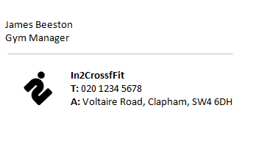
What is a signature?
An email signature is text that is automatically added to the bottom of an email
An employee might use their name and contact details for example

Slide 16

What is a search engine?
A search engine is an online tool that helps people find information on websites
What is a browser?
It is a piece of software on your computer that lets you visit webpages on the world wide web and use web applications
Internet browsers have some useful extra features
You can see which websites you’ve visited - History
You can bookmark your favourite web pages
Google
Bing
Yahoo
Ask

Slide 17
Is the information on a web page correct?
Who is the author of the page? Have you heard of them? Is there contact information?
Is the information up to date? When was it last updated?
What is the purpose of the page – information, public service, news source, advertising etc?
Is there a copyright symbol on the page? Who owns the copyright?
Are there any references?

